Slide 1
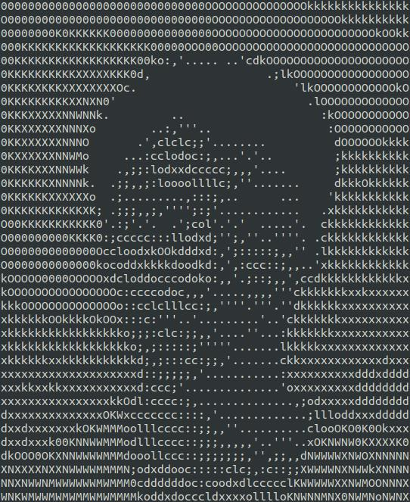



Tran Quoc Lap
Pham Thanh Hung
Hoang Nguyen Minh Nhat
NEWTON’s FORCE SIMULATOR
ID: 20194437
ID: 20194443
ID: 20194445

Slide 2
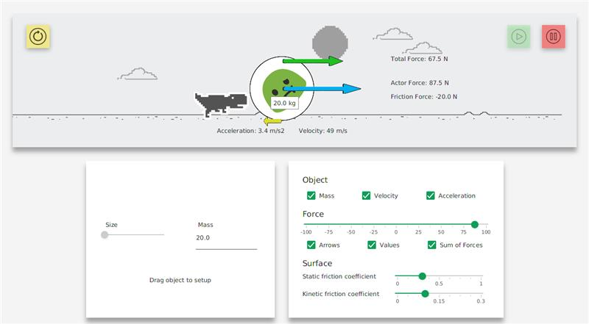
INTRODUCTION
An application which simulates some basic Newton forces’ behavior and allow users to adjust some attributes for better observation.

Slide 3
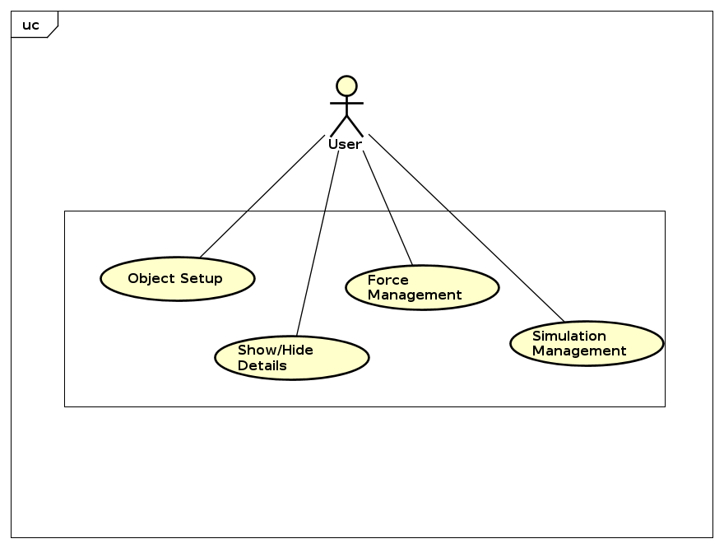
USE-CASE DIAGRAM

Slide 4
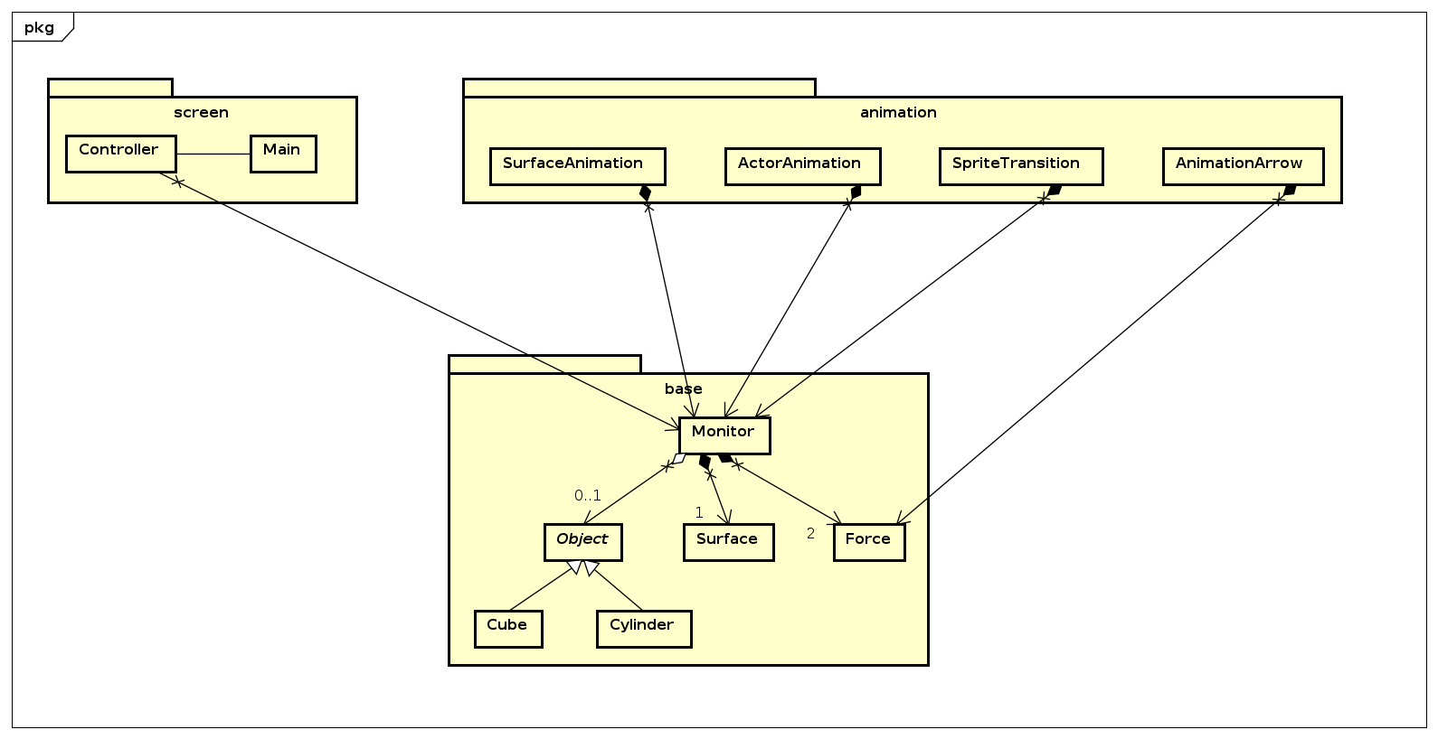
GENERAL CLASS DIAGRAM

Slide 5
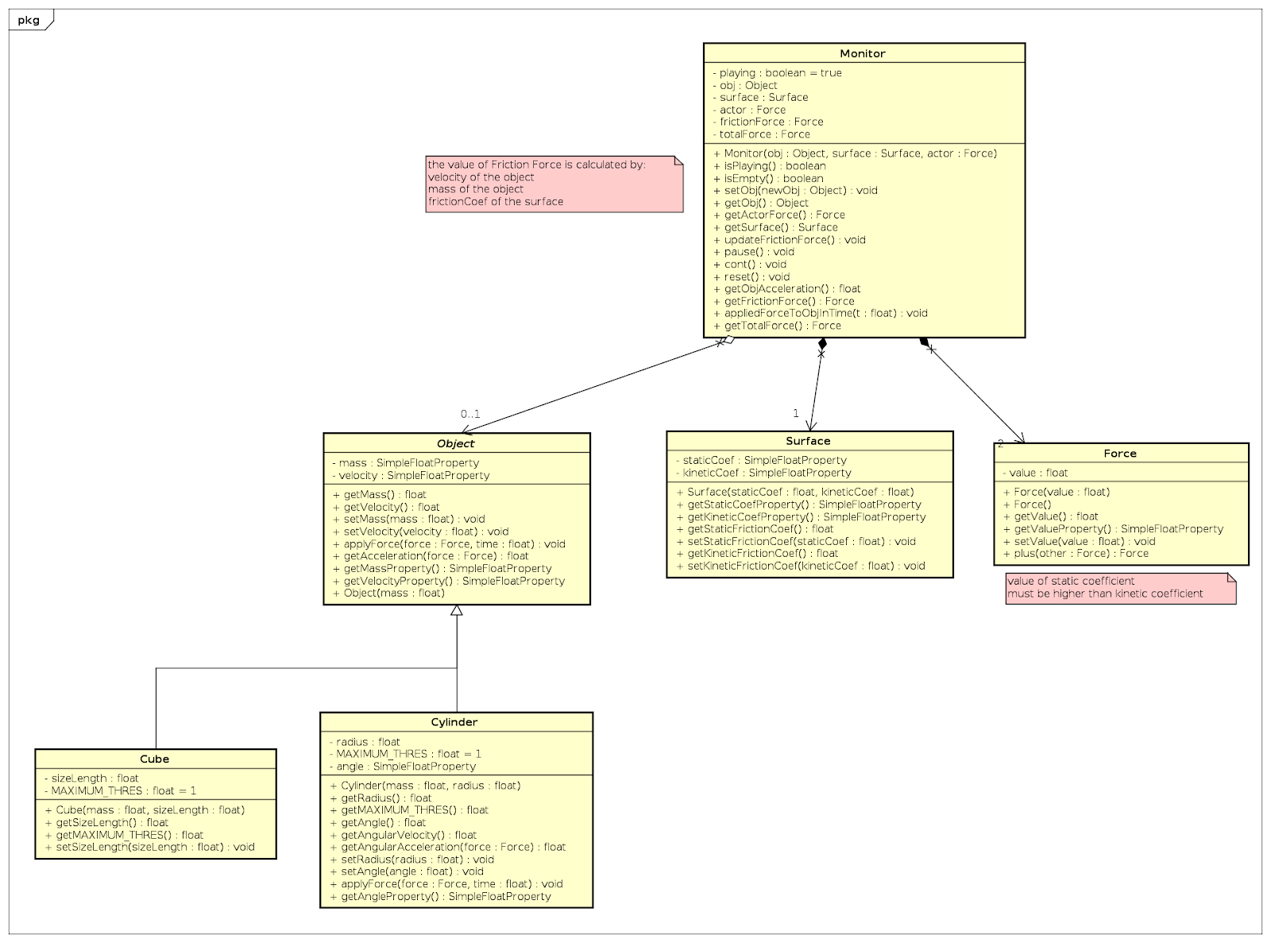
BASE PACKAGE CLASS DIAGRAM

Slide 6
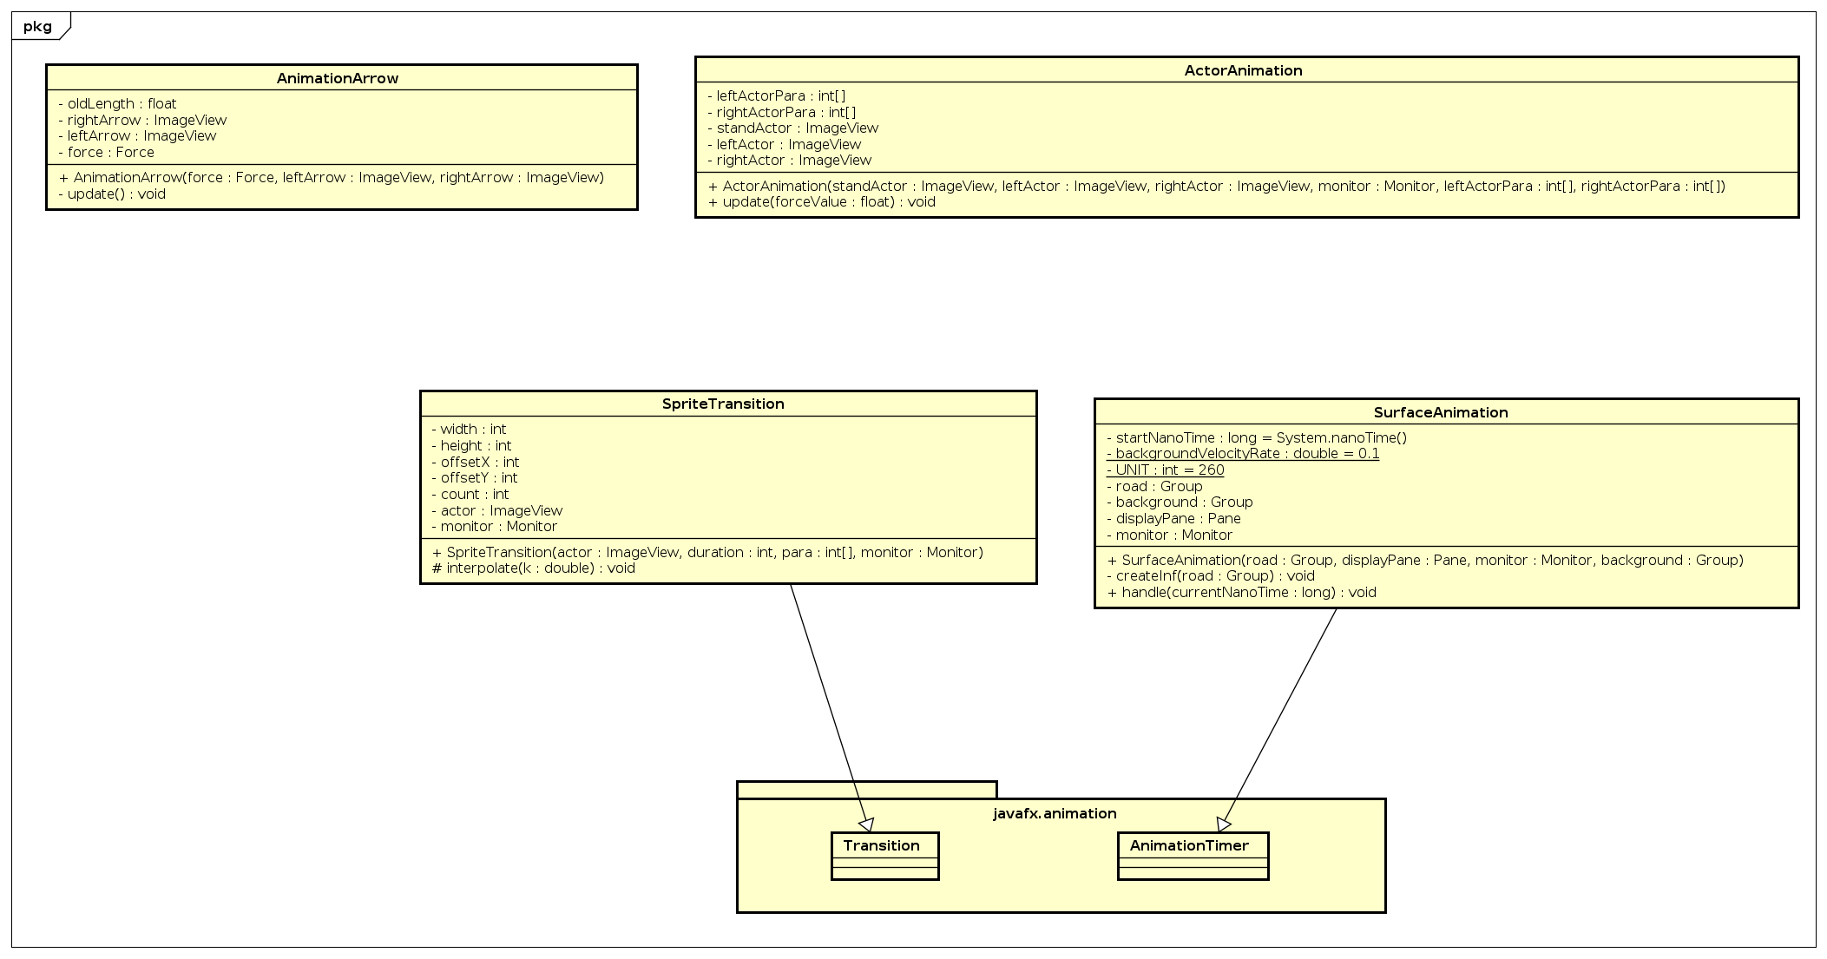
CLASS DIAGRAM FOR PACKAGES

Slide 7
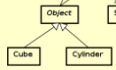
OOP TECHNIQUES
Abstraction
Inheritance
Object class is abstract class – to prevent creating Object instance and optimize method structure of Cube and Cylinder.
Example: Class Cube and class Cylinder inherit attributes and methods from class Object.

Slide 8
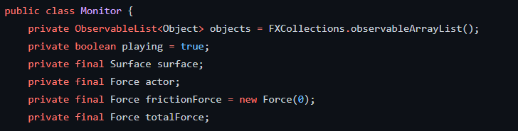
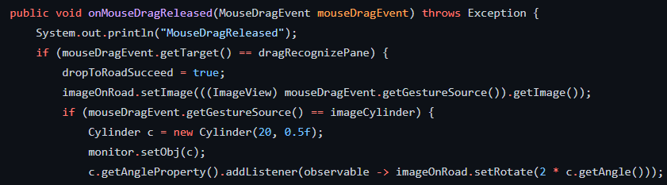
OOP TECHNIQUES
Encapsulation
Polymophism
Major attributes are set private for protecting information from out accessor
Apply upcasting and downcasting flexibly in various usage all over the appication

Slide 9
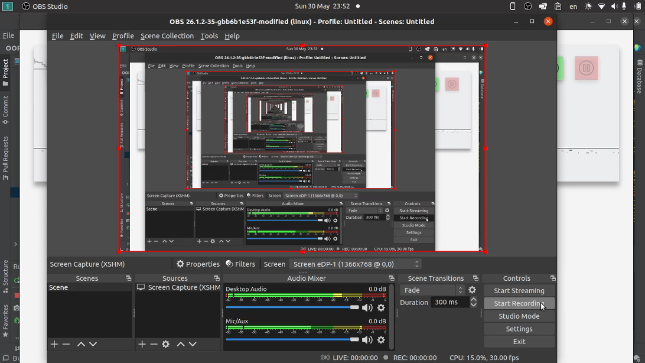
DEMO VIDEO

Slide 10

THANKS FOR LÍTENING
Do you have any questions?

